Slide 1
Green Marketing
Think green.
Group members:
Name – StudentID
Prince Dineshkumar Jodhani - 149455206
Sheida Tajali Ghoreishi – 116954165
Jiyu Kalpeshbhai Kholvadiya - 148939200
Juvairiya Mohammed Amin Shaikh - 145185203
You You - 107351215
Di Zhao - 115547218

Slide 2

What is Green marketing?
Green marketing is the practice of promoting a product or service in light of its benefits to the environment. These product and service are ecologically friendly in and of themselves.
"Green marketing" is the term used in the business world to describe any PR and educational campaigns that draw attention to or promote a product's environmental friendliness or the sustainability of its supply chain.
It is also know as Eco-marketing, environmental marketing.
When a company advertises its eco-friendliness, it could use the following products:
Not containing toxic materials or ozone-depleting substances
Produced from recycled materials or able to be recycled
Made from renewable materials
Not making use of excessive packaging
Designed to be repairable and not thrown away

Slide 3

Why is green marketing important?
There are numerous hazards to our world, including deforestation, food waste, water, and air pollution, and pollution from plastics. Since factory-produced chemicals are ubiquitous, many businesses are looking into more ecologically friendly ways to generate their goods. Additionally, consumers are becoming more environmentally concerned, and despite the increased cost of eco-friendly products, buyers are still ready to purchase them.
Businesses can use green marketing to help individuals change the planet for the better, recognize problems, and help the environment. Companies are trying to reduce the harmful impact of waste on the environment by developing sustainable products
Benefits:
Improve your credibility
Enter a new audience segment
Ensure long-term growth
Implement innovations
Obtain a higher revenue
Stand out in the increasingly competitive environment
Reduce the negative impact of production on the environment
Save energy, reduce the use of natural resources and carbon footprint
Produce recyclable products

Slide 4



How green marketing works?
Green marketing begins with a company actually implementing and practicing sustainable business methods. Authenticity is essential in green marketing.
Companies generally have three angles of highlighting their eco-friendliness:
The item used to make their products
The packaging the products are sold in
The actual products
Some companies highlight their recycled products and how they are made from recycled material. -This will impact in good impression on the customer's mind.
Restaurants and grocers are also known for their green marketing. For example, restaurants promote their food packaging from recycled material.
Many big companies like Samsung and apple also promote green marketing in their products.
All these things make a good impression on the consumers and benefit the environment.

Slide 5
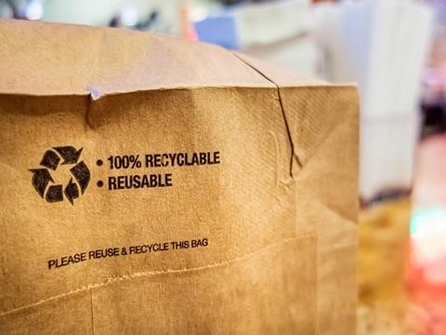
Green Marketing Strategies
1. Sustainable design:
When it comes to marketing, then sustainable design is the most important strategy everyone should follow.
When designing for sustainability, you have to consider a lot of things that have an impact on our environment.
2. Responsibility:
Responsibility plays an important role if you're thinking about becoming green, your brand needs to be prepared for significant changes.
Please revaluate your business from an ecological and social responsibility standpoint and show customers that you care about our world if you want to show that your objectives are sincere.
3. Green pricing:
Eco-friendly items frequently have a high value because of the additional cost of sustainable design.
Customers are still eager to pay for them, despite the hefty price. Therefore, if you charge more for your eco-friendly products, be sure to convey detailed facts to support the items worth money.
4. Eco-friendly packaging:
The over usage of plastic is the main reason for pollution on planet. Only approximately 9% of the 8.3 billion tons of plastic that have been created since the 1950s, according to Greenpeace, have been recycled.

Slide 6
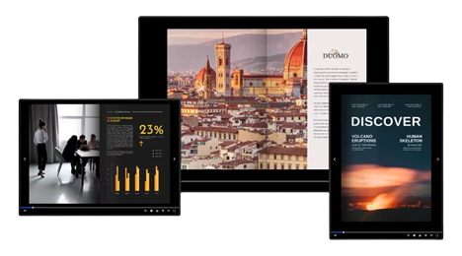
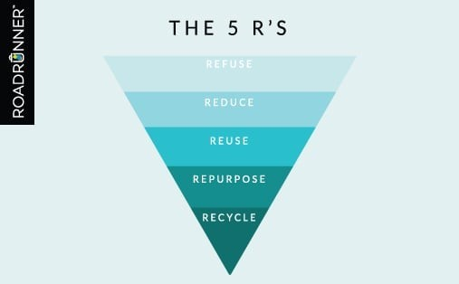
Green marketing ideas ready to implement for your business
Save paper, go digital
Follow the five Rs
Create green selling points
Go remote
Optimize your eCommerce shop
Promote your green efforts through marketing
What are the five Rs?
Refuse
Refuse: Refuse to waste.
Reduce
Reduce: In the ways that you can’t refuse, look for ways that you can reduce the waste.
Reuse
Reuse: To reduce waste, reuse items throughout the workplace instead of buying new ones.
Repurpose
Repurpose: For every item that can't be refused, reduced, or reused, try repurposing it.
Recycle
Recycle: Once you've gone through all the other R's, recycling is the most environmentally friendly waste disposal method.

Slide 7
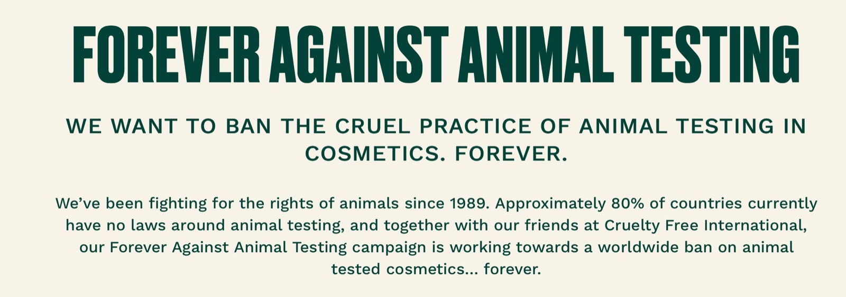
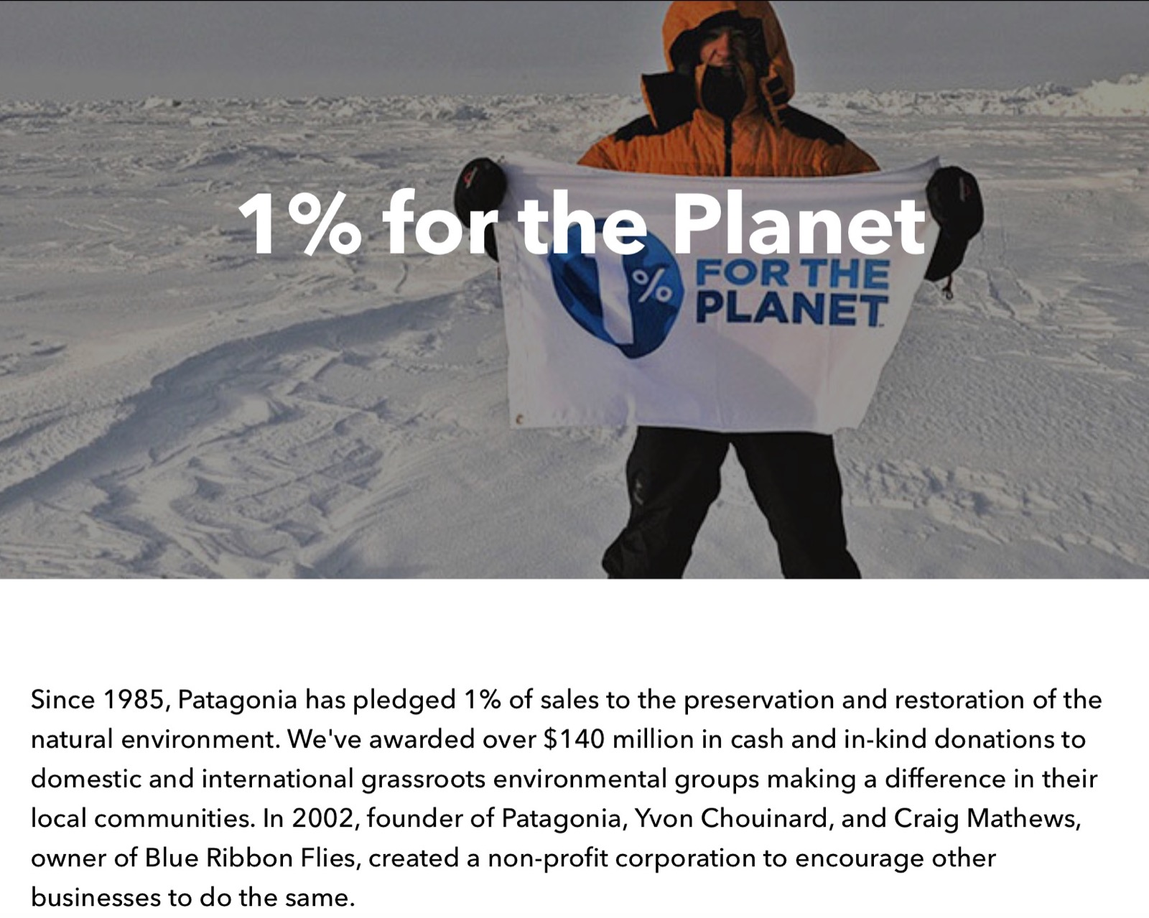
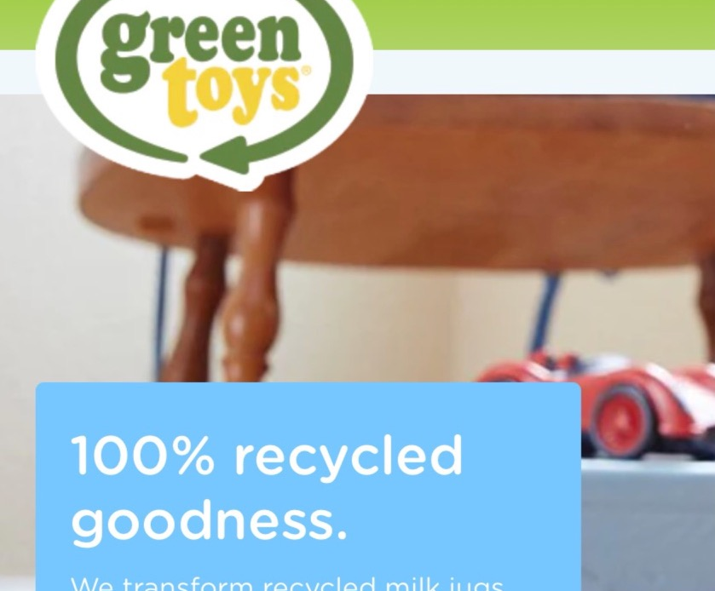


Slide 8
References:
Green marketing: Sales-oriented, yet environmentally conscious. (2021, November 25). Startup Guide IONOS. https://www.ionos.ca/startupguide/grow-your-business/what-is-green-marketing/
What is Green Marketing: Ideas and Examples. (2022, April 7). SendPulse. https://sendpulse.com/support/glossary/green-marketing
Ward, S. (2020, July 20). What Is Green Marketing? Definition& Examples of Green Marketing. Small business. https://www.thebalancesmb.com/green-marketing-2948347
Vos, L. (2019, January 22). What is Green Marketing? 5 Sustainable Examples to Know. Learn Hub. https://learn.g2.com/green-marketing
McDaniel, Z. (2022, April 13). Actionable tips for your green marketing strategy. Flipsnack Blog. Retrieved August 7, 2022, from https://blog.flipsnack.com/green-marketing-ideas/amp/#savepapergodigital
Bell, S. (2020, January 21). The 5 R's: Refuse, reduce, Reuse, repurpose, Recycle. Roadrunnerwm. Retrieved August 7, 2022, from https://www.roadrunnerwm.com/blog/the-5-rs-of-waste-recycling
Flaticon. (n.d.). Icons and vectors. https://www.flaticon.com

